Slide 1
Pak je wisbordje en je stift. succes !

Slide 2
10+1=

Slide 3
10 +10=

Slide 4
10+ 20=

Slide 5
10+ 30=

Slide 6
10+ 40=

Slide 7
10+ 5=

Slide 8
10+ 6=

Slide 9
10+ 7=

Slide 10
20 + 2=

Slide 11
20 + 4=

Slide 12
20 + 6=

Slide 13
20 +5=

Slide 14
20 + 10=

Slide 15
30 + 1=

Slide 16
30 + 3=

Slide 17
30 + 5=

Slide 18
30 + 6=

Slide 19
30 + 10=

Slide 20
40 + 2=

Slide 21
40 + 4=

Slide 22
40 + 6=

Slide 23
40 + 5=

Slide 24
40 + 10=

Slide 25
50 + 1=

Slide 26
50 + 3=

Slide 27
50 + 5=

Slide 28
50 + 6=

Slide 29
50 + 10=

Slide 30
60 + 2=

Slide 31
60 + 4=

Slide 32
60 + 6=

Slide 33
60 + 5=

Slide 34
60 + 10=

Slide 35
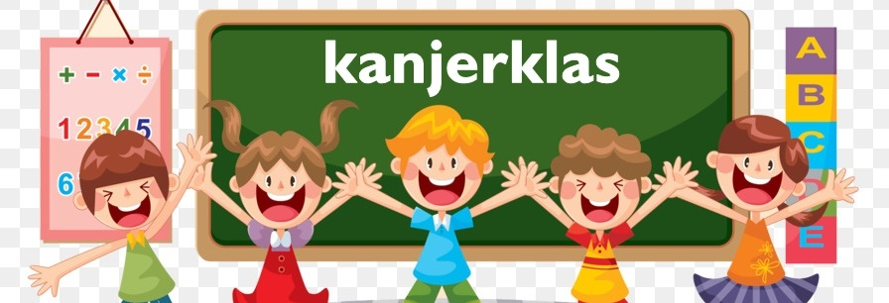
Welk getal komt op de ….

Slide 36
….-40-50-60

Slide 37
30-40-50-...

Slide 38
….-80-90-100

Slide 39
….-85-90-95

Slide 40
35- 40- 45-….

Slide 41
….-80-90-100

Slide 42
….- 85- 90- 95

Slide 43
….-35- 40- 45

Slide 44
….- 76- 78- 80

Slide 45
nu komen er x sommen

Slide 46
3 x 2=

Slide 47
4 x 2=

Slide 48
5 x 2=

Slide 49
6 x 2=

Slide 50
9 x 2 = 18 8 x 2 =

Slide 51
10 x 2=

Slide 52
2 x 5=

Slide 53
3 x 5=

Slide 54
4 x 5=

Slide 55
5 x 5=

Slide 56
10 x 5=

Slide 57
9 x 5 = 45 8 x 5 =

Slide 58
1 x 3=

Slide 59
2 x 3=

Slide 60
3 x 3=

Slide 61
4 x 3=

Slide 62
5 x 3=

Slide 63
10 x 3=

Slide 64
9 x 3 = 27 8 x 3 =

Slide 65
Let op - sommen

Slide 66
43-3=

Slide 67
52-2=

Slide 68
20-5=

Slide 69
35 –5=

Slide 70
30 – 5=

Slide 71
65 – 5=

Slide 72
70 –1=

Slide 73
80 – 2=

Slide 74
30 – 1=

Slide 75
30 – 3=

Slide 76
100 – 1=

Slide 77
50 – 5=

Slide 78
80 –1=

Slide 79
80 – 2=

Slide 80
80 – 3=

Slide 81
80 – 4=

Slide 82
80 – 5=

Slide 83
80 – 6=

Slide 84
80 – 7 =

Slide 85
80 – 8 =

Slide 86
80 – 9 =

Slide 87
80 –10=

Slide 88
84 – 2=

Slide 89
38 – 2=

Slide 90
66 – 2 =

Slide 91
54- 2=

Slide 92
73 – 2=

Slide 93
37 – 2=

Slide 94
14 – 2=

Slide 95
48 – 4=

Slide 96
65 – 4=

Slide 97
94 – 4=

Slide 98
88 – 4=

Slide 99
26 – 4=

Slide 100
49- 4=

Slide 101
Super goed !!

