Slide 1

kern start en kern 1

Slide 2
i

Slide 3
k

Slide 4
ik

Slide 5
m

Slide 6
m i k

Slide 7
k i m

Slide 8
s

Slide 9
s i m

Slide 10
m i s

Slide 11
p

Slide 12
p i m

Slide 13
k i p

Slide 14
s i p

Slide 15
aa

Slide 16
aa p

Slide 17
m aa k

Slide 18
r

Slide 19
r aa k

Slide 20
p aa r

Slide 21
m aa k

Slide 22
e

Slide 23
r e m

Slide 24
r i k

Slide 25
r e k

Slide 26
m e s

Slide 27
v

Slide 28
v aa k

Slide 29
v i s

Slide 30
v aa s

Slide 31
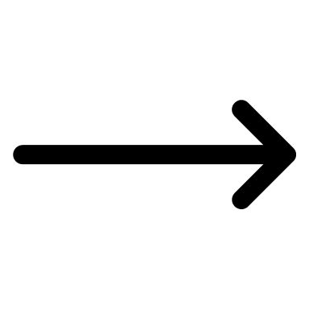
i s

Slide 32
e r

Slide 33
v e r

Slide 34
s i k

Slide 35
s a p

Slide 36
r a m

Slide 37
k a m

Slide 38
k a r

Slide 39
k a s

Slide 40
r a p

Slide 41
s i m

Slide 42
v a k

Slide 43
aa s

Slide 44
s i k

Slide 45
k i p

Slide 46
k a p

Slide 47
k a r

Slide 48
v i s

Slide 49
r aa p

Slide 50
v e r

Slide 51


Goed zo !

